Slide 1




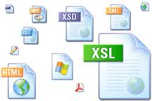
PHP Web Technologies
How can we connect web technologies with PHP
Mario Peshev
Technical Trainer
http://peshev.net/
Software University
http://softuni.bg

Slide 2

Table of Contents
WWW and URL
HTML, XML, JSON, RSS
HTTP Protocol: HTTP Request, HTTP Response
HTTP Cookies
AJAX Requests
Web Developer Tools

Slide 3


WWW and URL
What are these?

Slide 4
What is WWW?
WWW = World Wide Web = Web
Global distributed information system in Internet
A service in Internet (like E-mail, DNS, ...)
Consists of set of documents (and other resources) located on different Internet servers
Accessed through standard protocols like HTTP, HTTPS and FTP by their URL
Web servers provide Web content
Web browsers display the Web content

Slide 5
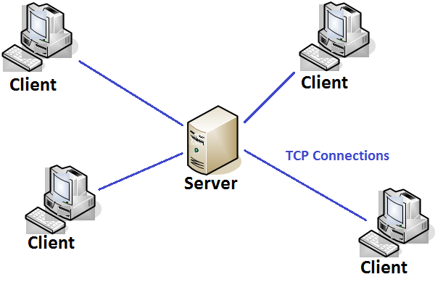
WWW Components
Structural components
Internet – provides data transfer channels over TCP, HTTP and other protocols
Clients (Web browsers)
display Web content
Web servers
IIS, Apache, Tomcat, GWS, etc.

Slide 6
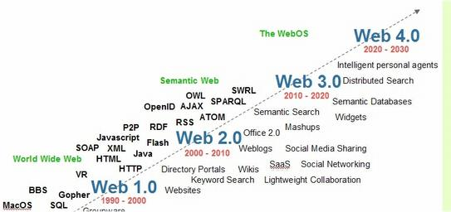
WWW Components
Semantic components
Hyper Text Transfer Protocol (HTTP)
Hyper Text Markup Language (HTML)
Uniform Resource Identifiers (URIs)
Uniform Resource Locator (URL)
Uniform Resource Name(URN)

Slide 7
WWW Infrastructure
Clients use Web browser application to request resources from the Web servers via HTTP
Resources have unique URL address
Servers send the requested resource as a response
Or reply with an error message
Web pages are resources in WWW
HTML text, graphics, animations and other files
Web sites are sets of Web pages in WWW

Slide 8
WWW Infrastructure (2)
Client’s browser renders Web pages returned by the Web servers
Pages are in HTML (Hyper Text Markup Language)
Browsers shows the text, graphics, sounds, etc.
HTML pages contain hyperlinks to other pages
The entire WWW system runs over standard networking protocols
TCP, DNS, HTTP, FTP, etc.
The HTTP protocol is fundamental for WWW

Slide 9
What is URL?
Uniform Resource Locator (URL)
Unique resource location in WWW, e.g.
It is just a formatted string, consisting of:
Protocol for communicating with the server (e.g., http, ftp, https)
Name of the server or IP address + optional port (e.g. www.softuni.bg, mail.bg:8080)
Path and name of the resource (e.g. Search/Results)
Parameters (optional, e.g. ?query=php)
https://softuni.bg/Search/Results?query=php

Slide 10
URL Encoding
URLs are encoded according RFC 1738:
All other characters are escaped with the formula:
Space can also be encoded as "+"
“... Only alphanumeric [0-9a-zA-Z], the special characters $-_.+!*'() and reserved characters used for their reserved purposes may be used unencoded within an URL.”
%[character hex code in ISO-Latin character set]

Slide 11
URL other characters - Examples
URLs are encoded according RFC 1738 in UTF-8
Chrome and Firefox translates the URL on copy
Character | Decimal code | Hex code | URL display
“ ” | 32 | 20 | %20
“{” | 123 | 7B | %7B
“}” | 125 | 7D | %7D
“/” | 47 | 2F | %2F
“\” | 92 | 5C | %5C
“a” | 53424 | D0B0 | %D0%B0
“я” | 53647 | D18F | %D1%8F

Slide 12
URL - Examples
Some valid URLs:
Some invalid URLs:
https://www.google.bg/webhp?sourceid=chrome-instant&ion=1&espv=2&ie=UTF-8#q=http%20get%20vs%20post
https://softuni.bg/trainings/fasttracks/details/1033
Should be: %D0%BF%D1%80%D0%BE%D0%B3%D1%80
%D0%B0%D0%BC%D0%B8%D1%80%D0%B0%D0%BD%D0%B5
http://www.kaldata.com/forums/forum/101-програмиране/
Should be: %D1%81%D0%BE%D1%84%D1%82%D1%83%D0%B5%D1%80
http://obekti.point.bg/search/софтуер

Slide 13







HTML, XML, JSON, RSS
Comparing the Common Web Data Formats

Slide 14

HTML
Hyper Text Markup Language (HTML)
Notation for describing formatted text with images and hyperlinks
Interpreted and displayed by the Web browsers
A Web (HTML) page consists of:
HTML file
CSS stylesheet file (optional)
A bunch of images (optional)
Other resources (optional)

Slide 15
HTML
HTML is straight-forward and easy to learn
HTML documents are plain text files
Easy to add formatting, hyperlinks, bullets, etc.
Images can be added as separate files
Can be automatically generated by authoring programs
Tools to help users creating HTML pages
E.g. FrontPage, Dreamweaver, Visual Studio
WYSIWYG HTML editors

Slide 16
HTML - Example
<!DOCTYPE html>
<html>
<head><title>HTML Example</title></head>
<body>
<h1>Heading 1</h1>
<h2>Sub heading 2</h2>
<h3>Sub heading 3</h3>
<p>This is my first paragraph</p>
<p>This is my second paragraph</p>
<div align="center"
style="background:skyblue">
This is a div</div>
</body>
</html>

Slide 17

XML
XML is markup-language for encoding documents in machine-readable form
Text-based format
Consists of tags, attributes and content
Provide data and meta-data in the same time
<?xml version="1.0"?>
<library>
<book><title>HTML 5</title><author>Bay Ivan</author></book>
<book><title>WPF 4</title><author>Microsoft</author></book>
<book><title>WCF 4</title><author>Kaka Mara</author></book>
<book><title>UML 2.0</title><author>Bay Ali</author></book>
</library>

Slide 18
JSON
JSON (JavaScript Object Notation)
Standard for representing simple data structures and associative arrays
Lightweight text-based open standard
Derived from the JavaScript language
{
"firstName": “Svetlin", "lastName": “Nakov", "age": 34,
"address": { "streetAddress": “26, Vassil Kunchev str.",
"city": "Sofia", "postalCode": "10021" },
"phoneNumber": [{ "type": "home", "number": "212 555-1234"},
{ "type": "fax", "number": "646 555-4567" }]
},
{ "firstName": “Gosho", "lastName": “Goshov", "age": 79 }

Slide 19


RSS
RSS (Really Simple Syndication)
Family of Web feed formats for publishing frequently updated works
E.g. blog entries, news headlines, videos, etc.
Based on XML, with standardized XSD schema
RSS documents (feeds) are list of items
Each containing title, author, publish date, summarized text and metadata
Atom protocol aimed to enhance / replace RSS

Slide 20
RSS - Example
<?xml version="1.0" encoding="UTF-8" ?>
<rss version="2.0">
<channel>
<title>W3Schools Home Page</title>
<link>http://www.w3schools.com</link>
<description>Free web building tutorials</description>
<item>
<title>RSS Tutorial</title>
<link>http://www.w3schools.com/rss</link>
<description>New RSS tutorial on W3Schools</description>
</item>
<item>
<title>XML Tutorial</title>
<link>http://www.w3schools.com/xml</link>
<description>New XML tutorial on W3Schools</description>
</item>
</channel>
</rss>

Slide 21


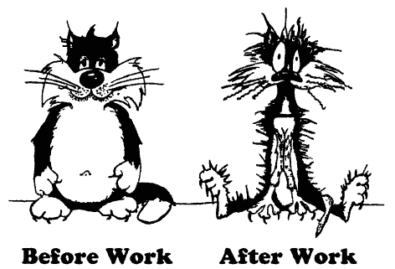
The HTTP Protocol
How HTTP Works?
HTTP

Slide 22
HTTP
Hyper Text Transfer Protocol (HTTP)
Client-server protocol for transferring Web resources (HTML files, images, styles, etc.)
Important properties of HTTP
Request-response model
Text-based format
Relies on a unique resource URLs
Provides resource metadata (e.g. encoding)
Stateless (cookies can overcome this)

Slide 23
HTTP: Request-Response Protocol
Client program
Running on end host
E.g. Web browser
Requests a resource
Server program
Running at the server
E.g. Web server
Provides resources
Request
Response
Set-Cookie: XYZ
Next request
Cookie: XYZ
23

Slide 24
HTTP - Example
HTTP request:
HTTP response:
GET / HTTP/1.1
Host: softuni.bg
User-Agent: Mozilla/5.0
The empty line denotes the end of the request header
HTTP/1.1 200 OK
Server: Microsoft-IIS/8.5
Date: Thu, 17 Jul 2014 12:11:44 GMT
Content-Length: 8560
<!DOCTYPE html>
…
The empty line denotes the end of the response header

Slide 25
HTTP Request Methods
HTTP request methods:
GET
Return the specified resource, run a program at the server or just download file
HEAD
Return the meta-data associated with a resource (headers only)
POST
Update a resource, provide input data for processing at the server

Slide 26
HTTP Response Codes
HTTP response code classes
1xx: informational (e.g., “100 Continue”)
2xx: success (e.g., “200 OK”)
3xx: redirection (e.g., “304 Not Modified”, "302 Found")
4xx: client error (e.g., “404 Not Found”)
5xx: server error (e.g., “503 Service Unavailable”)
"302 Found" is used for redirecting the Web browser to another URL

Slide 27
HTTP Request Message
Request message sent by a client consists of
Request line – request method (GET, POST, HEAD), resource URI, and protocol version
Request headers – additional parameters
Body – optional data
E.g. posted form data, files, etc.
<request method> <resource> HTTP/<version>
<headers>
<empty line>
<body>

Slide 28
HTTP GET Request - Example
GET / HTTP/1.1
Host: softuni.bg
Connection: keep-alive
Cache-Control: max-age=0
Accept: text/html,application/xhtml+xml,application/xml;q=0.9,image/webp,*/*;q=0.8
User-Agent: Mozilla/5.0 (Windows NT 6.3; WOW64) AppleWebKit/537.36 (KHTML, like Gecko) Chrome/36.0.1985.103 Safari/537.36
Accept-Encoding: gzip,deflate,sdch
Accept-Language: bg,en-US;q=0.8,en;q=0.6
HTTP request line
HTTP headers
The request body is empty

Slide 29
HTTP POST Request - Example
POST /account/login HTTP/1.1
Host: softuni.bg
Connection: keep-alive
Content-Length: 200
Cache-Control: max-age=0
Accept: text/html,application/xhtml+xml,application/xml;q=0.9,image/webp,*/*;q=0.8
Origin: https://softuni.bg
User-Agent: Mozilla/5.0 (Windows NT 6.3; WOW64) AppleWebKit/537.36 (KHTML, like Gecko) Chrome/36.0.1985.103 Safari/537.36
Content-Type: application/x-www-form-urlencoded
Referer: https://softuni.bg/account/authenticate
__RequestVerificationToken=D9303irA706r-tT2hHxLhiX8hpfo7bnc0YcvGqGRRmP-PpSh-fgAtl9fJ04ybeNZyQ2EVRp95kX_J35hF1Ow9G7RpJfyDeqi20Neu8yAmqc1&LoginUserName=Gosho&LoginPassword=gosho1sTheBest&LoginRememberMe=false
HTTP request line
HTTP headers
The request body contains the submitted form data

Slide 30
Conditional HTTP GET Request - Example
GET /Scripts/lazyPainter.js HTTP/1.1
Host: softuni.bg
Connection: keep-alive
Cache-Control: max-age=0
Accept: */*
If-None-Match: "0c5f1b54095cf1:0"
If-Modified-Since: Tue, 01 Jul 2014 15:25:38 GMT
User-Agent: Mozilla/5.0 (Windows NT 6.3; WOW64) AppleWebKit/537.36 (KHTML, like Gecko) Chrome/36.0.1985.103 Safari/537.36
Referer: https://softuni.bg/
Fetches the resource only if it has been changed at the server
Server replies with “304 Not Modified” if the resource has not been changed
Or “200 OK” with the latest version otherwise

Slide 31
HTTP Response Message
Response message sent by the server
Status line – protocol version, status code, status phrase
Response headers – provide meta data
Body – the contents of the response (the requested resource)
HTTP/<version> <status code> <status text>
<headers>
<empty line>
<response body – the requested resource>

Slide 32
HTTP Response - Example
HTTP/1.1 200 OK
Cache-Control: private
Content-Type: text/html; charset=utf-8
Content-Encoding: gzip
Vary: Accept-Encoding
Server: Microsoft-IIS/8.5
X-Frame-Options: SAMEORIGIN
X-Frame-Options: SAMEORIGIN
Date: Thu, 17 Jul 2014 12:11:44 GMT
Content-Length: 8560
<!DOCTYPE html>
…
HTTP response status line
HTTP response headers
HTTP response body

Slide 33
HTTP Response Error - Example
HTTP/1.1 404 Not Found
Server: nginx/1.2.4
Date: Thu, 17 Jul 2014 12:49:11 GMT
Content-Type: text/html; charset=utf-8
Transfer-Encoding: chunked
Connection: keep-alive
Vary: Accept-Encoding
Expires: Thu, 19 Nov 1981 08:52:00 GMT
Cache-Control: no-store, no-cache, must-revalidate, post-check=0, pre-check=0
Pragma: no-cache
X-FRAME-OPTIONS: SAMEORIGIN
Content-Encoding: gzip
<h2>Error</h2>
HTTP response status line
HTTP response headers
HTTP response body

Slide 34
Browser Redirection - Example
HTTP browser redirection example
HTTP GET requesting a moved URL:
GET / HTTP/1.1
Host: www.thefacebook.com
Connection: keep-alive
Accept: text/html,application/xhtml+xml,application/xml;q=0.9,image/webp,*/*;q=0.8
User-Agent: Mozilla/5.0 (Windows NT 6.3; WOW64) AppleWebKit/537.36 (KHTML, like Gecko) Chrome/36.0.1985.103 Safari/537.36
Accept-Encoding: gzip,deflate,sdch
Accept-Language: bg,en-US;q=0.8,en;q=0.6

Slide 35
Browser Redirection - Example
HTTP browser redirection example
The HTTP response says the browser should request another URL:
HTTP/1.1 301 Moved Permanently
Location: http://www.facebook.com/
Pragma: no-cache
Cache-Control: private, no-cache, no-store, must-revalidate
Expires: Sat, 01 Jan 2000 00:00:00 GMT
Content-Type: text/html; charset=utf-8
X-FB-Debug: psDcX9Hme6xz95MICUIL4hBx38gp+ JK0HV3fiEhdqNBaycrgcsoNl3lQ8sZT0wuBcV0K/16+L0xy/VZMUOoqxQ==
Date: Thu, 17 Jul 2014 13:17:46 GMT
Connection: keep-alive
Content-Length: 0

Slide 36
Content-Type and Disposition
The Content-Type header at the server specifies how the output should be processed
Examples:
UTF-8 encoded HTML page. Will be shown in the browser.
Content-Type: text/html; charset=utf-8
Content-Type: application/pdf
Content-Disposition: attachment;
filename="Financial-Report-April-2010.pdf"
This will download a PDF file named Financial-Report-April-2010.pdf

Slide 37
HTTP Cookies
Cookie
Cookies are pieces of data, stored by the client on behalf of the server
Included in all future HTTP requests to the server
Request
Response
Set-Cookie: XYZ
Next request
Cookie: XYZ

Slide 38
HTTP Cookies - Example
The client requests some URL:
The server sets a cookie in the HTTP response:
GET / HTTP/1.1
Host: www.google.bg
HTTP/1.1 200 OK
Set-Cookie: "PREF=ID=fb2c28f98c46c0de:FF=0:TM=1405603577:LM=1405603577:S=t5-0GoiYm3dWNH7J; expires=Sat, 16-Jul-2016 13:26:17 GMT; path=/; domain=.google.bg NID=67=stap-pci4zxItxiLp6S3IKimAlKYTfLg5z9xu D4AelWcxGfc3i0oresSGNFsIF6V70VRYs7bPsC5F5X76shUvCknYVEJUkteSC3Qg9Wx_mmvvMUlprBfNiwBwnONQp_H; expires=Fri, 16-Jan-2015 13:26:17 GMT; path=/; domain=.google.bg; HttpOnly"

Slide 39
HTTP Cookies - Example
In further requests to google.bg the Web browser sends the cookie in the HTTP header:
GET / HTTP/1.1
Host: www.google.bg
Cookie: PREF=ID=fb2c28f98c46c0de:U=3c5c60a95dfc8680:FF=0:TM=1405603577:LM=1405603611:S=lemd1UUEBAfOApYB; NID=67=stap-pci4zxItxiLp6S3IKimAlKYTfLg5z9xuD4AelWcxGfc3i0oresSGNFsIF6V70VRYs7bPsC5F5X76shUvCknYVEJUkteSC3Qg9Wx_mmvvMUlprBfNiwBwnONQp_H; OGPC=5-2:

Slide 40
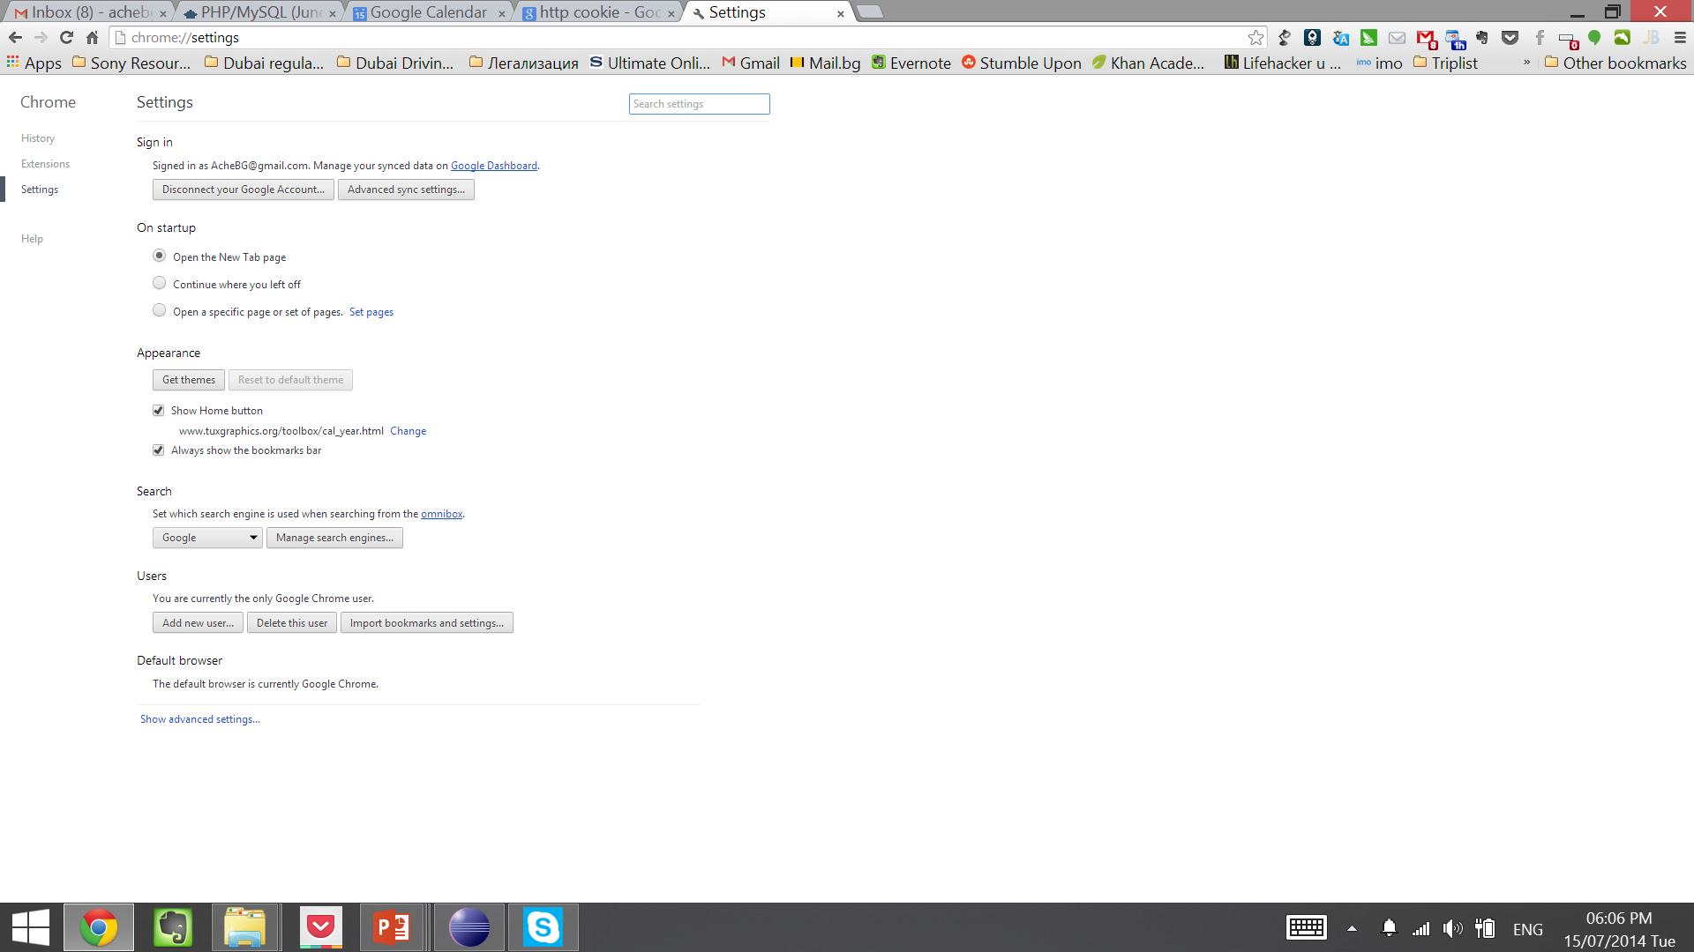
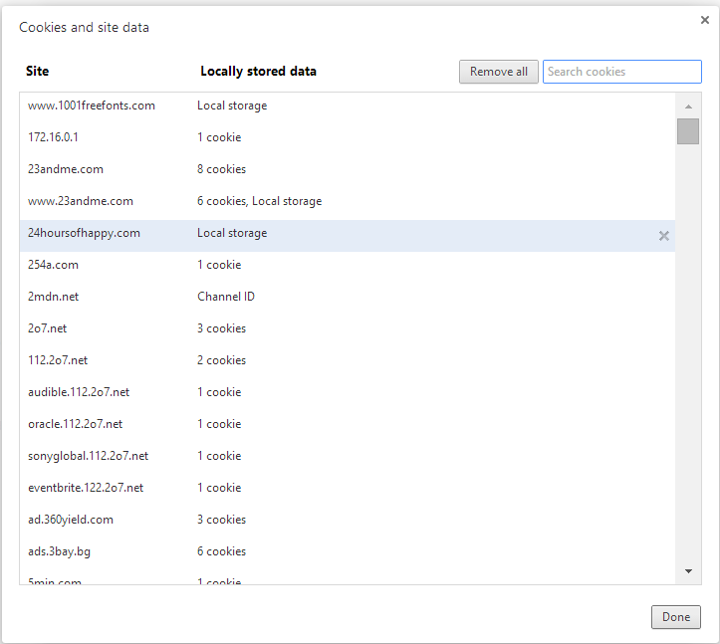
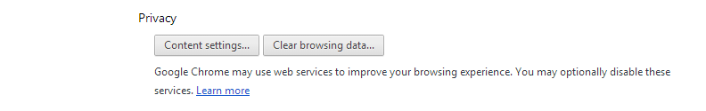
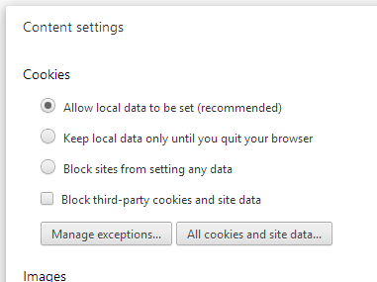
View HTTP Cookies in the Web Browser

Slide 41

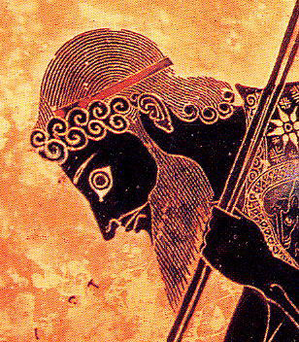
AJAX
Asynchronous JavaScript and XML

Slide 42
AJAX
AJAX is acronym of Asynchronous JavaScript and XML
Technique for background loading of dynamic content and data from the server side
Allows dynamic client-side changes
Two styles of AJAX
Partial page rendering – loading of HTML fragment and showing it in a <div>
JSON service – loading JSON object and client-side processing it with JavaScript / jQuery

Slide 43

Web Developer Tools (1)
Chrome DevTools
Web authoring and debugging tools built into Google Chrome
The easiest and most commonly used tool for Web Developers
Monitors network activity, source code and connections between files
Can add JavaScript break points for inspection
Provides inbuilt console

Slide 44


Web Developer Tools (2)
Firebug plug-in for Firefox
One of the best tools for Web developers
The ultimate tool for monitoring, editing and debugging HTTP, HTML, CSS, JavaScript, etc.
Free, open-source – www.getfirebug.com
Fiddler – HTTP proxy
Intercepts the HTTP traffic
Analyzes the HTTP conversation
Free tool – www.fiddler2.com

Slide 45

Web Developer Tools (3)
Wireshark packet analyzer
Low-level packet sniffer
Intercepts the entire IP network traffic
Can reconstruct the HTTP conversation
Can intercept any (unencrypted) protocol
IP, ICMP, TCP, UDP, HTTP, DNS, SMTP, POP3
Can intercept passwords sent in clear-text
Free, open-source project – www.wireshark.org

Slide 46

Summary
WWW and URL
HTML, XML, JSON, RSS
HTTP Protocol: HTTP Request, HTTP Response
HTTP Cookies
AJAX Requests
Web Developer Tools

Slide 47
http://softuni.org/courses

Slide 48

License
This course (slides, examples, demos, videos, homework, etc.) is licensed under the "Creative Commons Attribution-NonCommercial-ShareAlike 4.0 International" license
Attribution: this work may contain portions from
"Fundamentals of Computer Programming with C#" book by Svetlin Nakov & Co. under CC-BY-SA license
"C# Part I" course by Telerik Academy under CC-BY-NC-SA license

Slide 49





Free Trainings @ Software University
Software University Foundation – softuni.org
Software University – High-Quality Education, Profession and Job for Software Developers
softuni.bg
Software University @ Facebook
facebook.com/SoftwareUniversity
Software University @ YouTube
youtube.com/SoftwareUniversity
Software University Forums – forum.softuni.bg

